Slide 1
AUTOMATION AND CONTROL LABORATORY
Prof. Davide Tarsitano
Authors:
Andrea Verzaglia - 823568 Matteo Valenti - 823695
Ramtin Kamali - 840748 Roberto Ruggiero - 836521
A.Y. 2015/2016
AUTOMATION OF AN ELEVATOR PLANT

Slide 2

AUTOMATION OF AN ELEVATOR PLANT
INTRODUCTION

Slide 3

AUTOMATION OF AN ELEVATOR PLANT
INTRODUCTION
PLANT small-scale model of an elevator with 4 floors
Notes:
The purpose of our project was the AUTOMATION OF A SMALL-SCALE MODEL OF AN ELEVATOR WITH 4 FLOORS

Slide 4



AUTOMATION OF AN ELEVATOR PLANT
INTRODUCTION
WORK ORGANIZATION
MODELLING
IMPLEMENTATION
PLC
Simulink®
Stateflow®
STRUCTURED TEXT (IEC standard)
VISUALIZATION (GUI)
Notes:
We have started from the modelling of the system through the Matlab Simulink Tool Stateflow;
Then we have implemented the control strategy on the ABB PLC. The development environment was CoDeSys and we have used the STRUCTURED TEXT language, that is one of the IEC standard languages. CoDeSys allows us also to develop a Graphical User Interface in order to perform a simulation of our plant on the PC.

Slide 5
AUTOMATION OF AN ELEVATOR PLANT
INTRODUCTION
MAIN IDEA
BASIC
no memory for requests but the first
COMPLEXITY LEVEL
STORAGE
store all requests at any time
Notes:
The DESIGN PROCEDURE started from the BASIC LOGIC up to the LOGIC WITH STORAGE, increasing step by step the complexity level.
In the BASIC LOGIC there is not memory for the requests and only the first one is serviced;
While in the LOGIC WITH STRORAGE all request are stored at any time.

Slide 6
AUTOMATION OF AN ELEVATOR PLANT
BASIC
LOGIC

Slide 7

AUTOMATION OF AN ELEVATOR PLANT
BASIC LOGIC
REQUIREMENTS
NO MEMORY
EXTERNAL BUTTONS
BUSY STATE
STOP PUSHED
OBSTACLE
SAVE ENERGY
Notes:
First of all let’s focus on the BASIC LOGIC, the REQUIREMENTS are the following:
The ELEVATOR HAS TO CONTINUE to work regardless the BUTTONS PUSHED different from the first one. (that represents the actual destination floor)
The EXTERNAL BUTTONS of each floor have the same functionality (for example 1up/1down);
The «BUSY STATE» of the plant is declared turning on all external yellow LEDs;
If the STOP button is pushed while the elevator is moving, the cabin has to stop and the system waits for another button call. (This state is declared turning ON all external yellow LEDs)
If there is an OBSTACLE during the closing door procedure, the door has to stop to close and start to open immediately, and it can not be closed until the presence of the obstacle. Moreover the door has to re-open during the closing process also if the STOP button or the BUTTONS related to the current floor are pushed.
To SAVE ENERGY the CABIN LIGHT is turned off if no requests arrive within 10s.

Slide 8
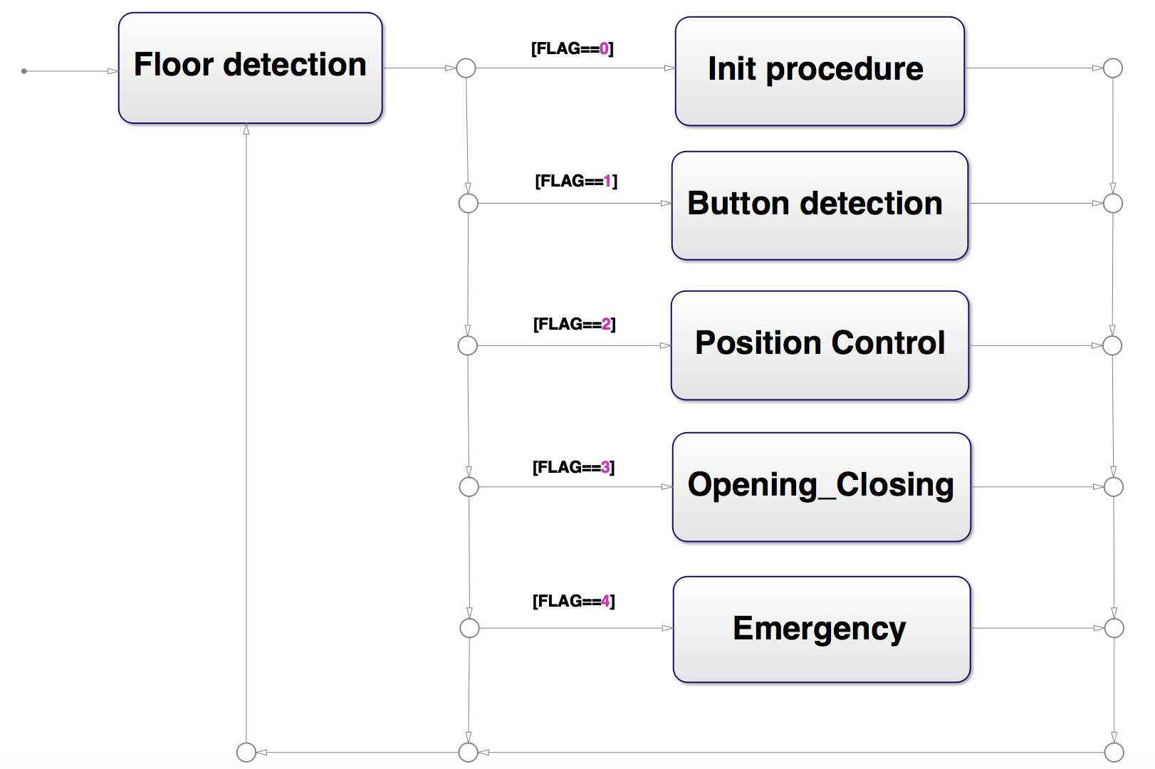
AUTOMATION OF AN ELEVATOR PLANT
BASIC LOGIC
MODELLING - MAIN
Notes:
Starting from the previous REQUIREMENTS, now let’s consider the model related to the MAIN of our software.
As we can see during all software iteration we pass through the FLOOR DETECTION in order to know the current cabin position.
Then, depending on the value of the variable FLAG we have 5 cases:
FLAG=0 means INIT PROCEDURE: this operation is done only once as the software is downloaded on PLC in order to bring the plant in a “NORMAL” WORKING CONDITION, that is the cabin at a floor and all doors closed. We can see this first operation as a recovery after an “OUT OF SERVICE” condition.
FLAG=1 means BUTTON DETECTION: it is used to detect the button CALL that has to be SERVICED.
FLAG=2 means POSITION CONTROL: it is used to bring the cabin to the desired floor.
FLAG=3 means OPENING/CLOSING PROCEDURE: it is used to open and close door as the cabin reaches the target floor.
Finally FLAG=4 means EMERGENCY: it is used to manage “EMERGENCY CONDITION”. More details will give in the following.
Notice that the FLAG value is changed properly during the program execution to switch from an operation to another.

Slide 9
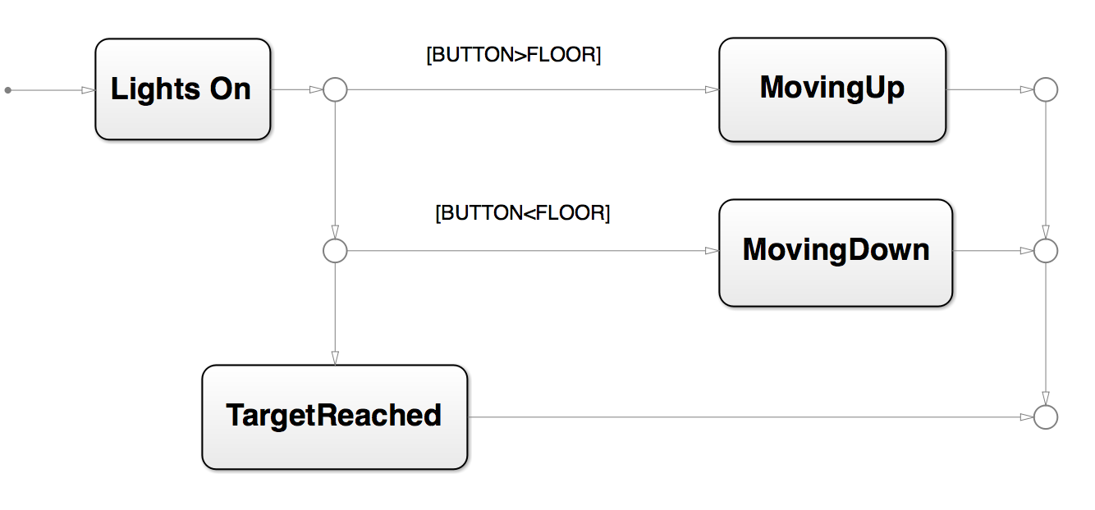
AUTOMATION OF AN ELEVATOR PLANT
BASIC LOGIC
MODELLING - POSITION CONTROL
20
Notes:
Finally let’s focus on the POSITION CONTROL, that has the main role in this logic:
as soon as the “first” button call is detected and stored through BUTTON variable, all external yellow LEDs are turned on to declare the “BUSY STATE” of the plant.
After that it is checked if the variable BUTTON is greater or less than the current FLOOR. In the first case the cabin will move UP, while in the second one it will move DOWN, till the target floor is reached, that is BUTTON=FLOOR.

Slide 10
AUTOMATION OF AN ELEVATOR PLANT
LOGIC WITH
STORAGE
Notes:
Let’s now consider the LOGIC WITH STORAGE!!!

Slide 11
AUTOMATION OF AN ELEVATOR PLANT
LOGIC WITH STORAGE
NEW REQUIREMENTS
MEMORY
SCAN ALGORITHM
EXTERNAL BUTTONS
LEDs
STOP PUSHED
Notes:
The significant difference of this second version of the software, modelled based on the logic with storage, is that while the elevator is working (during the car replacement and the opening/closing of the door), the pushed buttons, different from the first one, have to be memorised.
The mechanism is based on the SCAN algorithm. When a new request arrives while the system is idle, the initial movement will be in a direction (up or down), which depends on the current floor and the first pushed button. As additional requests arrive, they are serviced only in the current direction until the car reaches the farthest requested floor. When this happens, the direction of the car reverses, and the requests that were remaining in the opposite direction are serviced. The system keeps to work until all demands are satisfied.

Slide 12

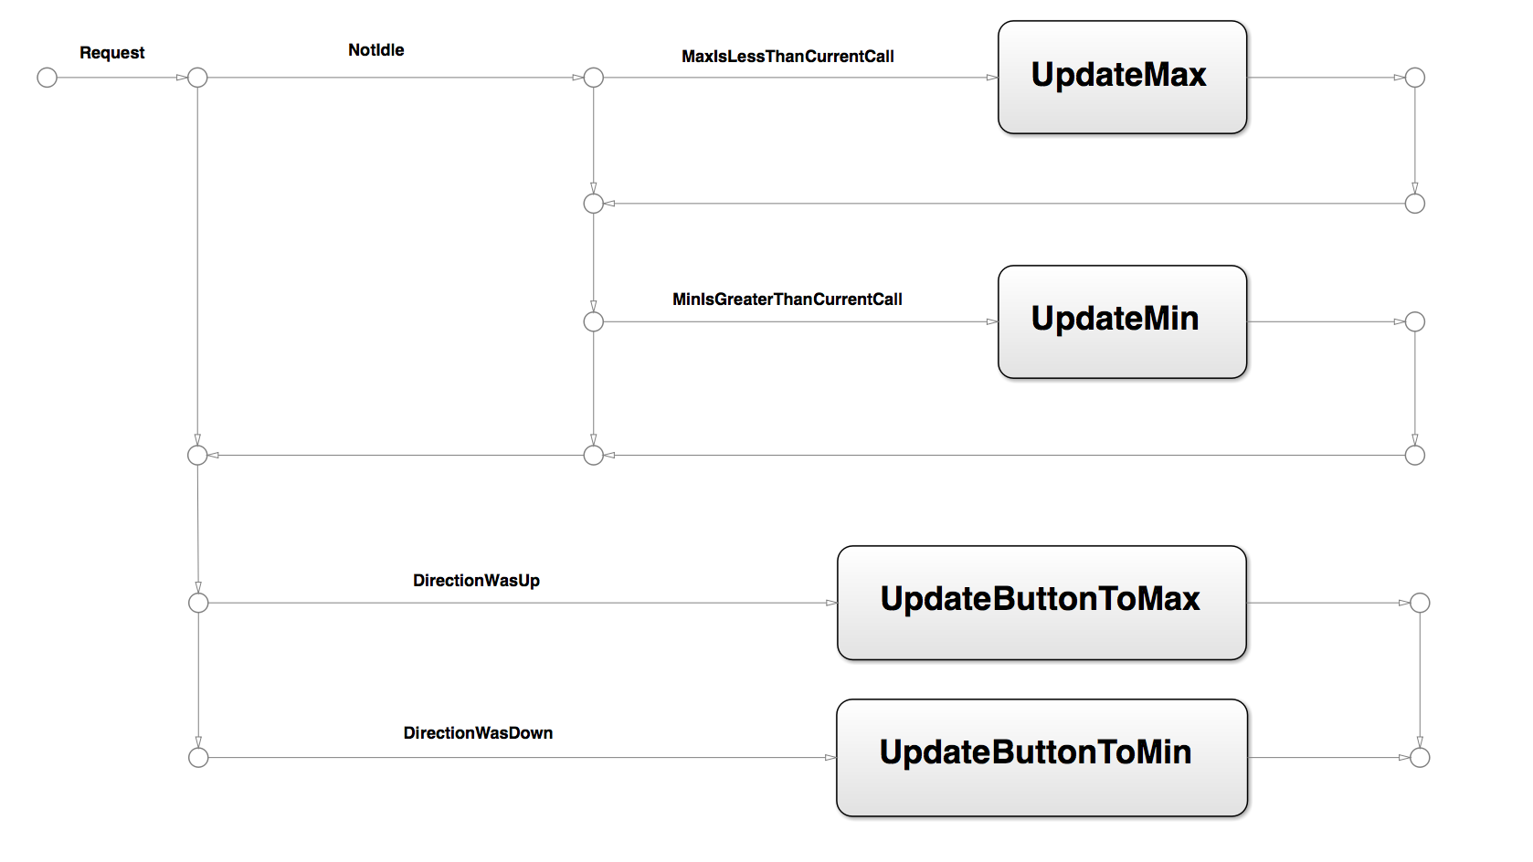
AUTOMATION OF AN ELEVATOR PLANT
LOGIC WITH STORAGE
BUTTON DETECTION
Button variable ?
Notes:
The key operation of this second logic is the button assignment. This value corresponds to the maximum or minimum, i.e. the highest or lowest floor requested, depending if the cabin has to go up or down.

Slide 13
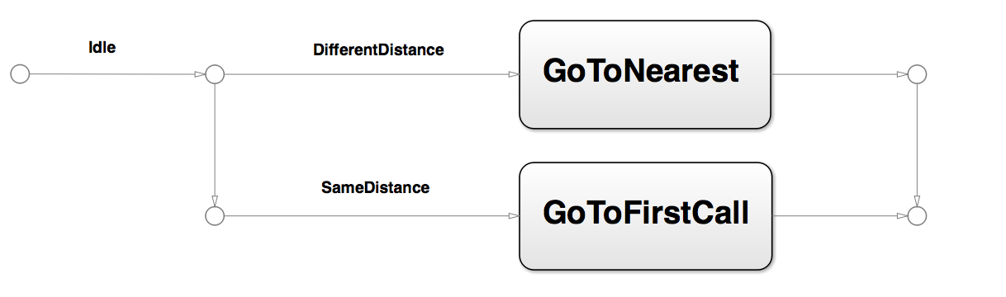
AUTOMATION OF AN ELEVATOR PLANT
LOGIC WITH STORAGE
BUTTON DETECTION
Starting from idle condition
SJF
FIFO
Notes:
We based on the SJF (Shortest Job First) algorithm which selects, as first call to be serviced, the nearest requested floor. It works as follows: we calculate the difference between the maximum floor request and minimum floor requested, that is the difference between MAX_BUT and MIN_BUT, and current floor.

Slide 14
AUTOMATION OF AN ELEVATOR PLANT
LOGIC WITH STORAGE
BUTTON DETECTION
Max and Min assignment
All requests satisfied in one direction
Updating in real-time
Notes:
The updating of maximum or minimum is executed in different way, according to the specific condition.

Slide 15
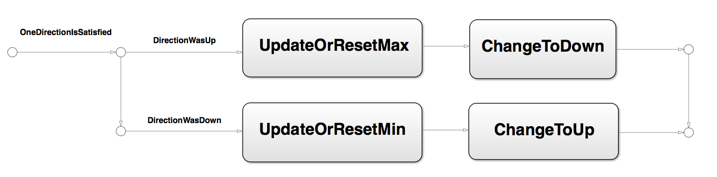
AUTOMATION OF AN ELEVATOR PLANT
LOGIC WITH STORAGE
ALL REQUEST SATISFIED IN ONE DIRECTION
Max and Min assignment
Notes:
All request in one direction are satisfied Max or Min are updated to the remaining outstanding request in the current direction or reset.

Slide 16
AUTOMATION OF AN ELEVATOR PLANT
LOGIC WITH STORAGE
REAL-TIME UPDATING
Max and Min assignment
Notes:
We update MAX_BUT, MIN_BUT depending on the current last button pressed.

Slide 17
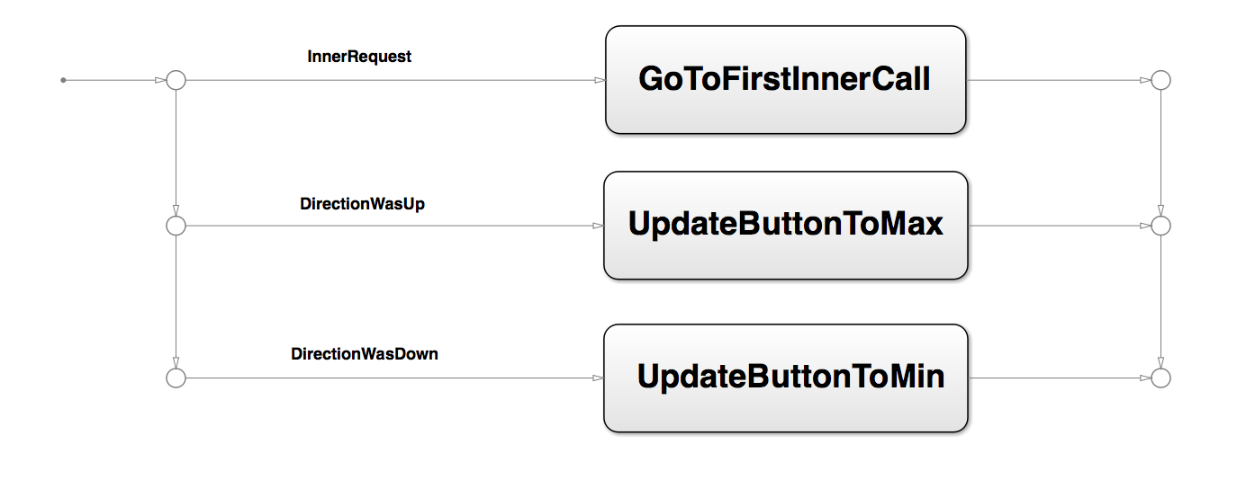
AUTOMATION OF AN ELEVATOR PLANT
LOGIC WITH STORAGE
CABIN PRIORITY (Logic with storage B)
Notes:
The basic idea is that we force a change of direction if necessary, not only when we reach a maximum or a minimum floor but also depending on the internal buttons pushed.

Slide 18
AUTOMATION OF AN ELEVATOR PLANT
SIMULATION

Slide 19
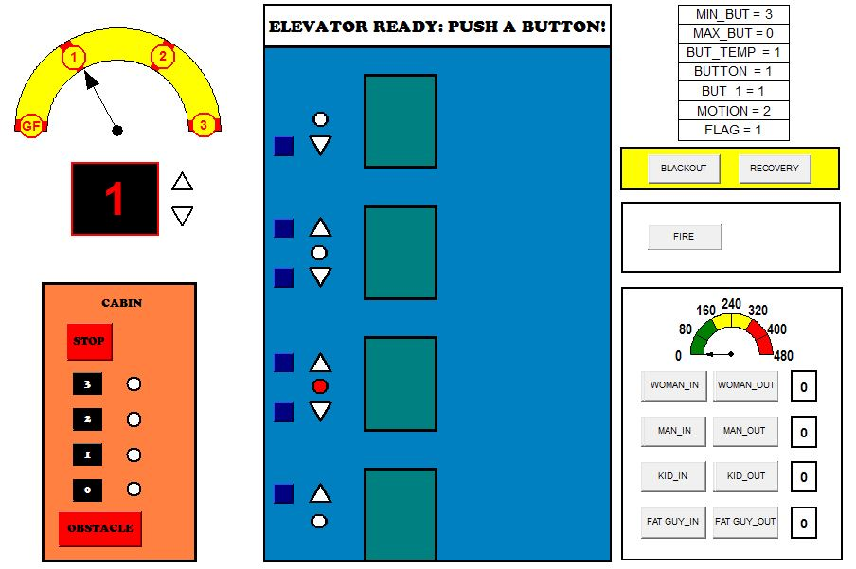
AUTOMATION OF AN ELEVATOR PLANT
SIMULATION
Notes:
The software that we use for

Slide 20
AUTOMATION OF AN ELEVATOR PLANT
ADDITIONAL
FEATURES

Slide 21




AUTOMATION OF AN ELEVATOR PLANT
ADDITIONAL FEATURES
LOAD CONTROL
BLACKOUT
FIRE
EMERGENCY

Slide 22

AUTOMATION OF AN ELEVATOR PLANT
ADDITIONAL FEATURES
LOAD CONTROL
TOTAL CABIN LOAD < 320kg
22
Notes:
Avoiding doors closing and cabin movement if the load is greater than 320Kg
People entering/exiting simulated through interface
22

Slide 23

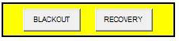
AUTOMATION OF AN ELEVATOR PLANT
ADDITIONAL FEATURES
BLACKOUT
BLACKOUT
RECOVERY
NORMAL WORKING CONDITION
23
Notes:
Simulating absence of power supply assuming the presence of an emergency generator (to recover)
Stop cabin waiting for RECOVERY command (simulated)
Stored calls are cleared (version with memory)
Execute Emergency procedure once RECOVERY has been activated
23

Slide 24



AUTOMATION OF AN ELEVATOR PLANT
ADDITIONAL FEATURES
FIRE
3 seconds
FIRE
EMERGENCY
NORMAL WORKING CONDITION
24
Notes:
Simulating firing situation at one or more floors
Stop cabin and reset all stored calls (in memory version)
Set FLAG_EMG to execute Emergency nextly
24

Slide 25
AUTOMATION OF AN ELEVATOR PLANT
ADDITIONAL FEATURES
ILLNESS
3 seconds
ILLNESS
EMERGENCY
NORMAL WORKING CONDITION
3 seconds
25
Notes:
Executed if:
STOP is pushed for more than 3 seconds
After a Fire situation
After a Blackout situation
Cabin is moved to the lower nearest floor
Doors are kept opened at a floor
Without anyone of them the regular functioning is recovered
25

Slide 26
AUTOMATION OF AN ELEVATOR PLANT
ANALYSIS
OF RESULTS
Notes:
Talking about results , In the following I’ll bring 2 short scenario in order to understand how our logics work

Slide 27


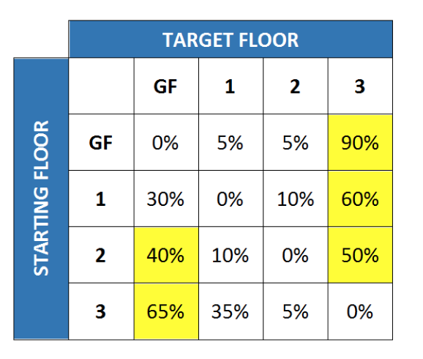

AUTOMATION OF AN ELEVATOR PLANT
ANALYSIS OF RESULTS
BASIC LOGIC vs LOGIC WITH STORAGE
Scenario: lunch time in a commercial building
3→0
2→0
0→3
Notes:
Imagine a commercial building with a resturant in its 3° floor during the lunch time. Based on this frequency table prided here, we define a scenario as following
Assume the cabin is in the 3° floor. A user wants to go to ground floor from there, another one calls it from second floor at the same time to go to GF and maybe have lunch outside and the last call here to go to the top

Slide 28
AUTOMATION OF AN ELEVATOR PLANT
ANALYSIS OF RESULTS
BASIC LOGIC vs LOGIC WITH STORAGE
Basic logic sequence : 3 > 0 > 3 > 2 > 0
Storage logic sequence: 3 > 2 > 0 > 3
Notes:
So, let’s see what happened,
The sequence that the cabin is expected to follow, in the basic logic, is, carries first user 3° to Ground , for 3° user, ground to top and lastly to second floor and ground floor
However it differs in storage logic which is top to second and then carries first and second users together to the ground and lastly sevres the 3° user and put her at the top

Slide 29
AUTOMATION OF AN ELEVATOR PLANT
ANALYSIS OF RESULTS
Notes:
Here the timing results of the previous scenario are provided, although for some user we have more travelling or waiting time in storage logic, as we expeted the overall elevator usage is less.

Slide 30
AUTOMATION OF AN ELEVATOR PLANT
ANALYSIS OF RESULTS
LOGIC STORAGE A vs LOGIC STORAGE B
2→3
1→0
Notes:
Another thing which is worth mentioning is the comparison between explained storage A and B and again an example will help to understand better the situation
So assume cabin is in ground floor and a call’s recieved from 1° floor to go down. And another from 2°. The first user enters and 2 separate decisions can be made based on the different storage logic .

Slide 31
AUTOMATION OF AN ELEVATOR PLANT
ANALYSIS OF RESULTS
LOGIC STORAGE A vs LOGIC STORAGE B
Storage A sequence: 0 > 1 > 2 > 3 > 0
Storage B sequence: 0 > 1 > 0 > 2 >3
Notes:
With storage A the sequence will be as follows:
Ground to first, assume the first user enters and the cabin continues serving another call in the same current direction, so goes to 2 and then 3° and lastly put the first user at ground floor.
However it varies in storage B which there is a cabin priority, firstly it services the first user by putting her at her desired floor and goes for another one.

Slide 32
AUTOMATION OF AN ELEVATOR PLANT
ANALYSIS OF RESULTS
Notes:
Here you can see the timing results of the previous scenario, and generally we have a better results again for the storage A in the sense of elevator usage.

Slide 33
AUTOMATION OF AN ELEVATOR PLANT
CONCLUSION
BASIC logic
PROS: privacy and shortest travelling time for current user
CONS: waiting time for another user
Notes:
As conclusion there are both advatages and disadvantages for any logics
The advantage in basic is a kind of provided privacy for a user at a time but
The disadvantage can be bothering other users at that moment by increasing the waiting time

Slide 34
AUTOMATION OF AN ELEVATOR PLANT
CONCLUSION
STORAGE logic
A
CONS: no cabin priority
B
PROS: cabin priority, timing
CONS: stuck in a range of floors
PROS: all floors reached in one direction, timing
Notes:
About the storage I can say that
The main advantage of the storage A is that we assure all calls are serviced in one direction every time
However, no cabin priority is considerd
It is solved in the storage B, although the cabin can be stuck in a range of floors by a selfish user
At the end we are confident enough that our implementation can be used in any elevator with very tiny changes

Slide 35
AUTOMATION OF AN ELEVATOR PLANT
SIMULATION
VIDEOS

Slide 36
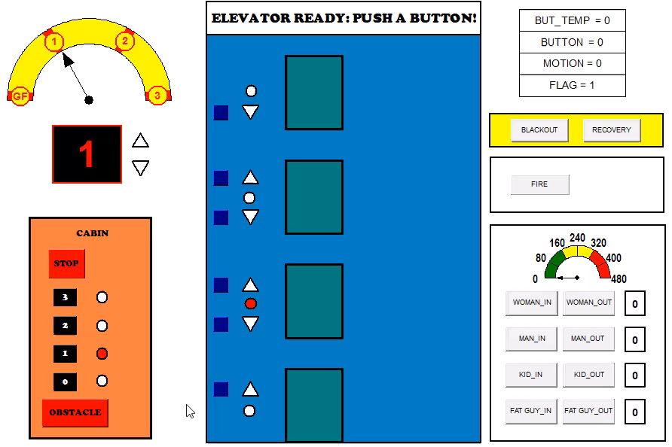
BASIC LOGIC
NO MEMORY
PEOPLE ENTERING SIMULATION
STOP BUTTON PUSHED
PEOPLE EXITING SIMULATION
OBSTACLE
PEOPLE EXITING SIMULATION
DOOR
RE-OPENING

Slide 37
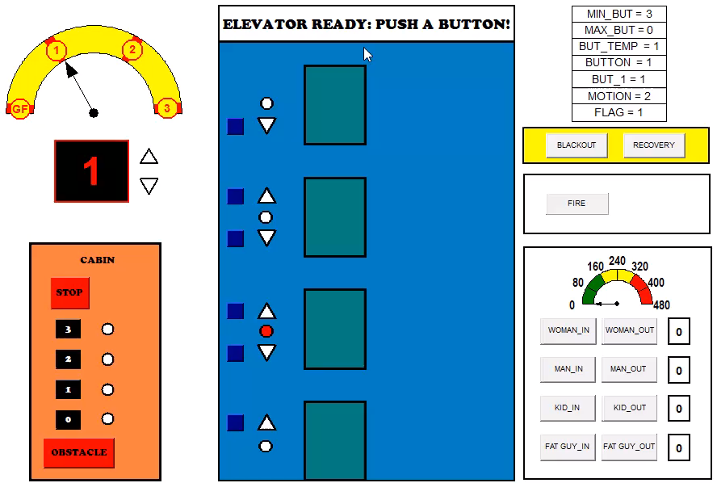
LOGIC WITH STORAGE
CHANGE OF DIRECTION
INTERMEDIATE STOP
SAVE ENERGY
ILLNESS
RETURN TO NORMAL WORKING
REQUEST SKIPPED

Slide 38

AUTOMATION OF AN ELEVATOR PLANT
THANK YOU
FOR
YOUR ATTENTION

